Slide 1
shop – E
Guide : Santosh Katti
- Sahana T J (PES1201802160)
- Rahul C Shekhar (PES1201802486)
- Jeevan Jagadish (PES1201801855)

Slide 2
INTRODUCTION
shop – E is an online shopping app.
Items can be added to a wishlist.
Items can be bought immediately or can be added to a cart with multiple items and complete payment.
Different offers will be offered.
Items will be listed category wise.

Slide 3
REQUIREMENTS
Android Studio
Facebook Fresco

Slide 4
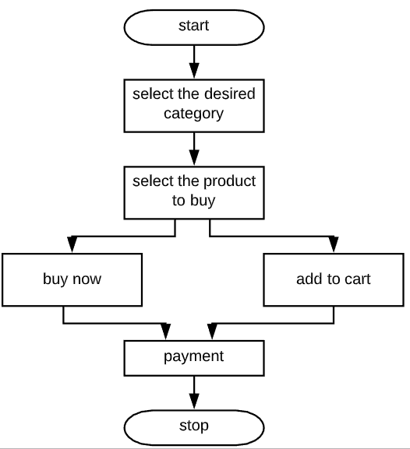
DESIGN

Slide 5

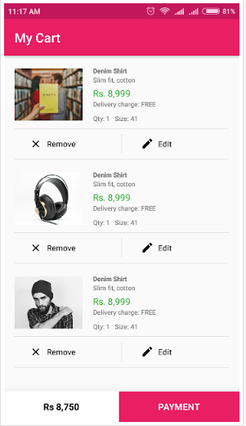
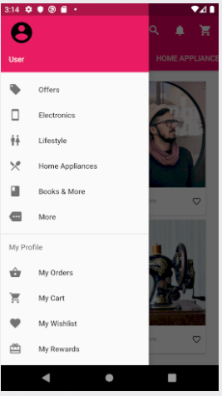
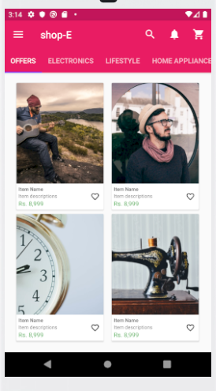
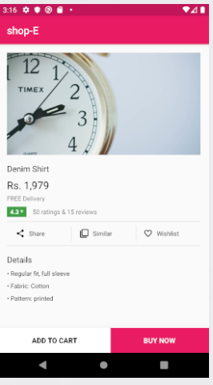
SCREENSHOTS

Slide 6
FUTURE COMMITMENTS
List cart items.
Log In and Registration.
Implement wishlist.

Slide 7
THANK YOU

